Slide 1
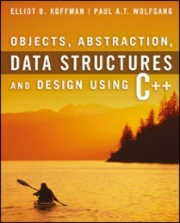
Welcome to
CS 235 Data Structures
Queues/Deques, 6.1-3 (19)

Slide 2
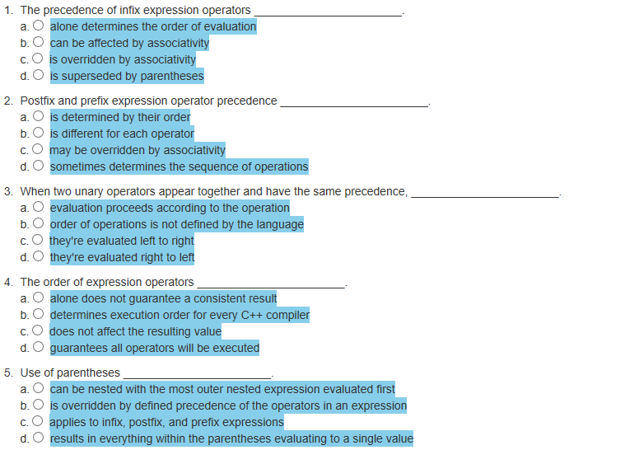
Attendance Quiz #18

Slide 3
Tip #19: C++ Enum's
enum wind_directions_t { NO_WIND,
NORTH_WIND,
SOUTH_WIND,
EAST_WIND,
WEST_WIND };
wind_directions_t windDirection = NO_WIND;
windDirection = 453; // doesn't work, we get a compiler error!
The idea behind enumerated types is to create new data types that can take on only a restricted range of values.
Moreover, these values are all expressed as constants rather than magic numbers--in fact, there should be no need to know the underlying values.
The names of the constants should be sufficient for the purposes of comparing values.

Slide 4
Lab 05 – Expressions

Slide 5
Requirements
Input is an expression string in infix notation.
Expression: 43 + 2 * 19
Use an ExpressionManager class to hold your infix, postfix, (and prefix) expressions.
Your class should be derived from the abstract interface class ExpressionManagerInterface.
Implement member functions:
virtual int value(void);
virtual string infix(void);
virtual string postfix(void);
virtual string prefix(void);
Output the resulting infix, postfix, (prefix), and integer evaluation value of the expression.
Your calculations should perform integer division and produce integer results.

Slide 6
Example Input / Output
Input
Output
Expression: 43 + 2 * 19
Infix:
Postfix:
Prefix:
Value:
Expression: 43 + 2 * 19
Infix: 43 + 2 * 19
Postfix: 43 2 19 * +
Prefix: + 43 * 2 19
Value: 81
Input
Output
Expression: 2 + 3 - 5
Infix:
Postfix:
Prefix:
Value:
Expression: 2 + 3 - 5
Infix: 2 + 3 - 5
Postfix: 2 3 + 5 -
Prefix: - + 2 3 5
Value: 0
Why not Prefix: + 2 - 3 5

Slide 7
ExpressionManager Class
Inherits from ExpressionManagerInterface
class ExpressionManager :
public ExpressionManagerInterface
{
private:
string expression_;
std::vector<string> inFix_;
std::vector<string> postFix_;
std::vector<string> preFix_;
string operators = "([{ -+ */% ";
public:
ExpressionManager(string exp) :
expression_(exp) { }
~ExpressionManager() { }
virtual int value(void);
virtual string infix(void);
virtual string postfix(void);
virtual string prefix(void);
virtual string toString(void) const;
}
Index/4 is the operator precedence.
Expression: 43 + 2 * 19
Infix:
Postfix:
Prefix:
Value:
43 + 2 * 19
43 2 19 * +
+ 43 * 2 19
81
Infix checks for balance and invalid operators/operands.
Return Postfix and Prefix expressions.

Slide 8
ExpressionManager Class
Expression: 43 + 2 * 19
Infix:
Postfix:
Prefix:
Value:
<<Interface>>
ExpressionManagerInterface
43 + 2 * 19
43 2 19 * +
+ ExpressionManager(void)
+ ~ExpressionManager(void)
+ virtual value(void): int
+ virtual infix(void): string
+ virtual postfix(void): string
+ virtual prefix(void): string
+ virtual toString(void) const: string
+ 43 * 2 19
81
ExpressionManager is-a ExpressionManagerInterface
ExpressionManager
infix checks for balance and invalid operators/operands.
- expression_ : string
- inFix_ : vector<string>
- postFix_ : vector<string>
- preFix_ : vector<string>
+ ExpressionManager(exp: string)
+ ~ExpressionManager(void)
+ value(void): int
+ infix(void): string
+ postfix(void): string
+ prefix(void): string
+ toString(void) const: string
prefix conversion is "similar" to postfix.

Slide 9
Reporting Expression Errors
Expression: { { 2 + 4 }
Infix: Unbalanced
1st Check for Balance
throw "Unbalanced"
Expression: ( 43 + + 2 * 19
Infix: Unbalanced
2nd Return 1st occurrence of an error.
Expression: ( 43 + + 2 ) * 19 20
Infix: Missing Operand
Two adjacent operators
throw "Missing Operand"
Expression: -
Infix: Missing Operand
Expression: 3 $ 3
Infix: Illegal Operator
Illegal operator
throw "Illegal Operator"
Expression: 4 % 2 5 -
Infix: Missing Operator
More operands than operators (operators = operands + 1)
throw "Missing Operator"
Expression: 21 +
Infix: Missing Operand
Expression: + 7 1
Infix: Missing Operand
Expression: 43 + 2 * 19 +
Infix: Missing Operand
Expression: 3 % { 7 - ( 2 / [ 5 - 81 ] } + 1 )
Infix: Unbalanced

Slide 10
Requirements
Points | Requirement (50 Points)
10 | Correctly converts expressions to infix notation. (lab05_in_01.txt) Note: The autograder will NOT squish horizontal spaces!
10 | Correctly converts valid expressions (with parentheses) to postfix notation. (lab05_in_02.txt)
10 | Correctly evaluates valid expressions. (lab05_in_03.txt)
10 | Correctly detects unbalanced and invalid infix expressions. (Throws an error.) (lab05_in_04.txt)
10 | Correctly converts valid expressions (with parentheses) to prefix notation. (lab05_in_05.txt)
-10 | Memory leaks, g++ compiler warnings, or array out-of-bounds detected.
Points | Peer Review
2 | An ExpressionManager class is used to contain an expression and is derived from the abstract interface class ExpressionManagerInterface.
2 | Your ExpressionManager class throws an error for invalid expressions.

Slide 11
inFix to PreFix
Given two operands a and b and an operator ,
The infix notation implies that  will be placed in between a and b.
When the operator is placed after both operands , it is called postfix notation.
And when the operator is placed before the operands  a b, the expression in prefix notation.
Example: To convert “(A + B) * C” to prefix:
Reverse the infix expression
(A+B)*C becomes C*(B+A).
Note: while reversing each ‘(‘ will become ‘)’ and each ‘)’ becomes ‘(‘.
Obtain the postfix expression (almost) of the modified expression.
Push operator on stack if greater than or equal.
C*(B+A) becomes CBA+*.
Reverse the postfix expression.
CBA+* becomes the prefix expression *+ABC.

Slide 12
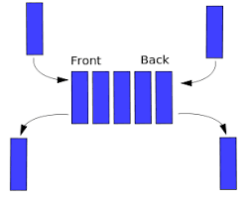
Chapter 6 – Queues and Deques

Slide 13
Chapter 6 Objectives
To learn how to represent a waiting line (queue) with a Queue ADT and functions for insertion (push), removal (pop), and for accessing the element at the front (front).
To understand how to implement the Queue ADT using a single/double-linked list or a circular array.
To understand how to simulate the operation of a physical system that has one or more waiting lines using queues and random number generators.
To introduce the standard library Deque class.
The queue, like the stack, is a widely used data structure, but differs from a stack in one important way
a stack is LIFO list – Last-In, First-Out
while a queue is FIFO list – First-In, First-Out

Slide 14
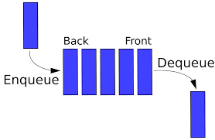
6.1 The Queue Abstract Data Type
A Queue of Customers
A Print Queue
The Unsuitability of a "Print Stack''
Specification of the Queue ADT
6.1, pgs. 358-362

Slide 15
Queue Abstract Data Type
The queue, like the stack, is a widely used data structure, but differs from a stack in one important way
a stack is LIFO list – Last-In, First-Out
while a queue is FIFO list – First-In, First-Out
Computing examples:
A web-site which serves files to thousands of users.
CPU jobs must be batched up and then scheduled.
In a breadth-first ("shallowest"-first) search of a graph.
Super computers for synchronizing parallel execution of threads.
The producer–consumer who share a common buffer as a queue.
Other real-world examples:
We wait in queues at check-out counters in grocery stores.
We wait in queues to enter movie theaters.
We wait in queues to drive on a turnpike.
We wait in queues to ride on a roller coaster.

Slide 16
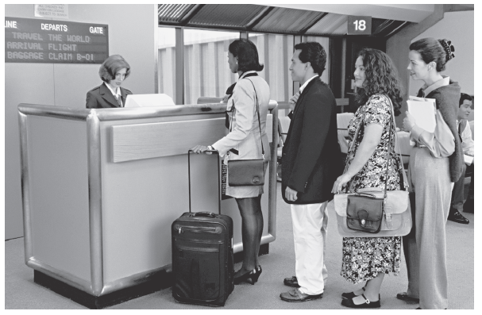
Queue Abstract Data Type
The queue, like the stack, is a widely used data structure, but differs from a stack in one important way
a stack is LIFO list – Last-In, First-Out
while a queue is FIFO list – First-In, First-Out
A queue can be visualized as a line of customers waiting for service
The next person to be served is the one who has waited the longest.
New elements are placed at the end of the line.

Slide 17
Queue Examples
Imagine you have a web-site which serves files to thousands of users.
You can only handle 100 requests at a time.
A fair policy would be first-come-first-serve - serve 100 at a time in order of arrival.
In a multitasking operating system, the CPU cannot run all jobs at once.
Jobs must be batched up and then scheduled according to some "FIFO" policy.
The producer–consumer problem describes two processes, the producer and the consumer, who share a common buffer as a queue.
The producer's job is to generate data and put it into the buffer.
The consumer consumes the data one piece at a time.

Slide 18
Queue Examples
Other computing examples:
In a breadth-first ("shallowest"-first) search of a graph, you would use a queue to store nodes as you discover them.
Parallel processing with super computers use queues to synchronized parallel execution threads.
Other real-world examples:
We wait in queues at check-out counters in grocery stores.
We wait in queues to enter movie theaters.
We wait in queues to drive on a turnpike.
We wait in queues to ride on a roller coaster.
Game Applications:
Algorithms that explore mazes of interconnected rooms use queues to keep track of which options have not yet been explored.
Avatars pass messages to one another.

Slide 19
Print Queue
Operating systems use queues to
keep track of tasks waiting for a scarce resource
ensure that the tasks are carried out in the order they were generated.
Print queue: printing typically is much slower than the process of selecting pages to print, so a queue is used.

Slide 20
Specification for a Queue Interface
Because only the front element of a queue is visible, the operations performed by a queue are few in number.
We need to be able to retrieve the front element, remove the front element, push a new element onto the queue, and test for an empty queue.
The functions above are all defined in the header file for the STL container queue, <queue>.

Slide 21
Maintaining a Queue of Customers
#include <iostream>
#include <queue>
#include <string>
using namespace std;
const string choices[] =
{ "push", "front", "pop", "queue", "quit" };
enum { PUSH, FRONT, POP, QUEUE, QUIT, END };
int main()
{
queue<string> customers;
string name;
string option;
cout << "Welcome to the customer queue";
do
{
cout << endl << "Select option: ";
getline(cin, option);
switch (option[0] - '0')
{
// ------------------------------------------>>>>>>
case QUIT:
cout << "Leaving customer queue";
break;
}
} while (option[0] - '0' != QUIT);
return 0;
}
case PUSH:
cout << "Enter new customer name: ";
getline(cin, name);
customers.push(name);
break;
case FRONT:
if (customers.empty()) break;
cout << "Customer " << customers.front();
cout << " is next in line";
break;
case POP:
if (customers.empty()) break;
cout << "Customer " << customers.front();
cout << " removed from the line";
customers.pop();
break;
case QUEUE:
cout << "Customers (" << customers.size() << "):";
for (int i = 0; i < customers.size(); ++i)
{
cout << " " << customers.front();
customers.push(customers.front());
customers.pop();
}
break;
default:
cout << "Options:";
for (int i = 0; i < END; ++i)
cout << endl << " " << i << ": " << choices[i];
break;

Slide 22
std::list as a Queue Container
The standard library defines the queue as a template class that contains any of the sequential containers (list or vector).
Like the stack class, the queue is said to be an adapter class because it adapts the functions available in another class to the interface that a client expects (by giving different names to functions with essentially the same operations).
Since the sequential container list provides the push_back and pop_front functions, it can be adapted to a queue.
For example, if a list is used as the container object,
queue::push would correspond to list::push_back. (Note: A singly-linked list requires a tail pointer in addition to the head.)
queue::front would correspond to list::front.
queue::pop would correspond to list::pop_front.
This is called “delegation”.

Slide 23
Using std::list as a Queue Container
#include <list>
template<typename Item_Type>
class queue
{
private:
// Insert implementation-specific data fields
std::list<Item_Type> container;
public:
queue();
}; // End class queue
The queue adapts the list container!
/** Pushes an item onto the back of the queue.
@param item The item to be inserted */
void push(const Item_Type& item) container.push_back(item);
/** Returns a reference to the object at the front of the queue without removing it.
@return A reference to the object at the front of the queue */
Item_Type& front() container.front();
/** Returns a const reference to the object at the front of the queue without removing it.
@return A const reference to the object at the front of the queue */
const Item_Type& front() const container.front();
/** Removes the front item from the queue. */
void pop() container.pop_front();
Every function is delegated!
/** Determines whether the queue is empty. */
bool empty() const container.empty();
/** Returns the number of items in the queue */
size_t size() const container.size();

Slide 24
Be Safe

